Slide 1
Digital Image Processing
ISE-2
Presented by:
Rushikesh Korde (2017BTECS00053 )
Saurabh Zade(2017BTECS00077)
Rahul Sonone (2017BTECS00103)
Mangesh Cheke (2015BCS024)

Slide 2
Problem Statement
Automatic bottle filling inspection system using image processing.

Slide 3
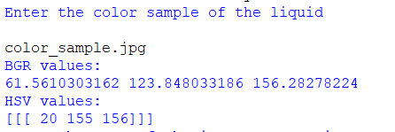

Algorithm
Take the color sample of liquid and convert it to HSV

Slide 4
Set the lower And upper bounds of the Image
lower = np.array([hsv[0][0][0]-5, hsv[0][0][1]-50, hsv[0][0][2]-50])
upper = np.array([hsv[0][0][0]+5, hsv[0][0][1]+50, hsv[0][0][2]+50])

Slide 5
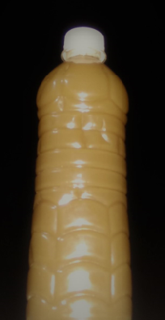
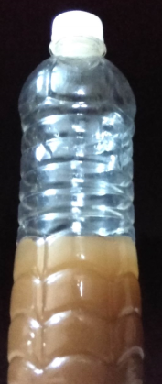
Input image for checking the filled level
Convert the image to HSV representation
img = cv2.imread(image_name)
img =
cv2.cvtColor(img, cv2.COLOR_BGR2HSV)

Slide 6
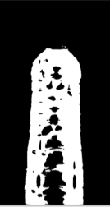

Mask the bits for the pixels which are in predefined range
mask = cv2.inRange(img, lower, upper)

Slide 7
Find the height of first few pixels from the top
Find out amount of bottle filled
Assumption:
Standard height : 80 % of the height of the image
If bottle filled above 80 % consider it as full
else notified as empty bottle

Slide 8
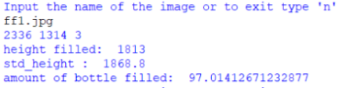
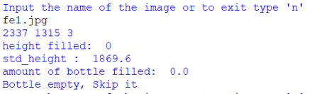
Results

Slide 9
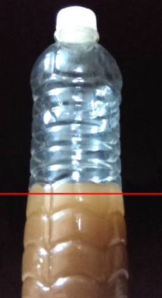
Level Detected on the image

Slide 10
Thank You

